Slide 1

CAN Protocol By: Nageswaridevi Bandaru
Software Engineer

Slide 2
Agenda
Layered Structure
CAN types
CAN Frame Formats
Arbitration in CAN
Types of Errors

Slide 3

INTRODUCTION
CAN Protocol
CAN(Controller Area Network).
CAN has developed by Robert Bosch in 1985.
CAN standard is ISO-11898.
CAN is a broadcast type of bus.
CAN is a Message based protocol.
CAN is an Asynchronous Serial Communication protocol.
CAN is a two wired communication protocol.
Speed of CAN is 1Mbps.
It is a Half duplex.

Slide 4
Why CAN/Advantages
Prioritization of message.
Guarantee of Latency time.
Configuration flexibility.
Multi master.
Error Detection and Signaling.

Slide 5
Before CAN
Lightning
Power Seats
Engine Control
Anti-Lock Brakes
Airbag
Dashboard
Power Windows
Air Condition
Transmission Control
Active Suspension

Slide 6
With CAN
Lightning
Power Seats
Engine Control
Anti-Lock Brakes
Airbag
High Speed
Dashboard
Low Speed
Power Windows
Air Condition
Transmission Control
Active Suspension

Slide 7
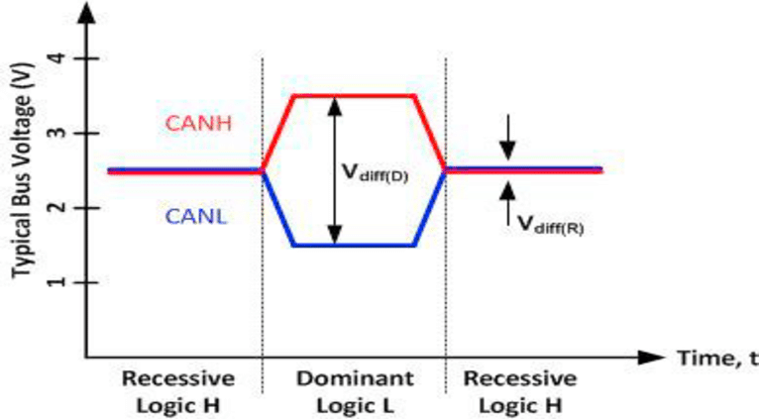
CAN Voltages at Logic H and L:

Slide 8
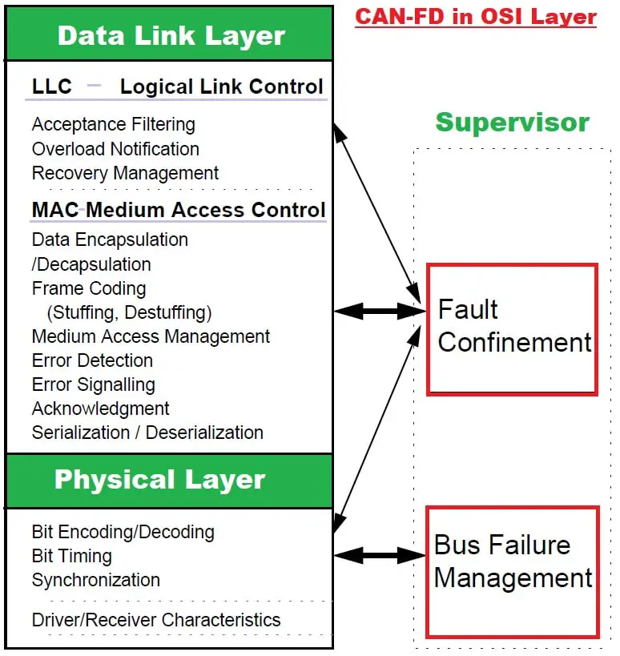
Layered Structure

Slide 9
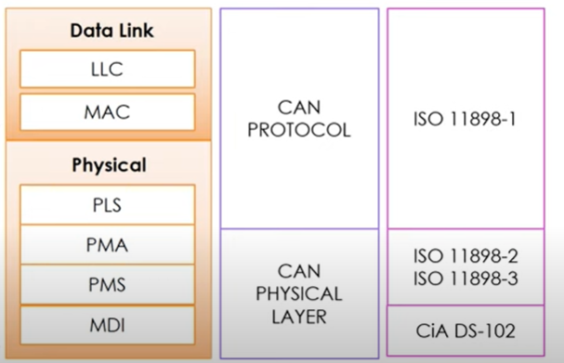
High Speed CAN-1Mbps
Low Speed CAN-125kbps

Slide 10
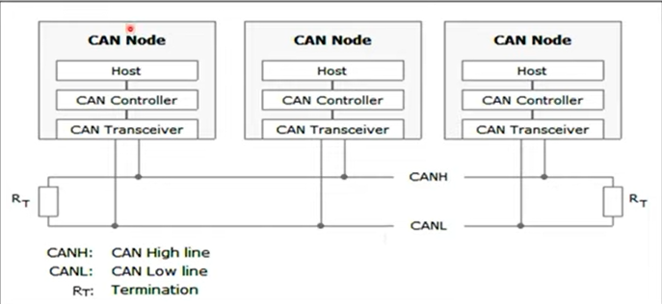
CAN Controller:

Slide 11
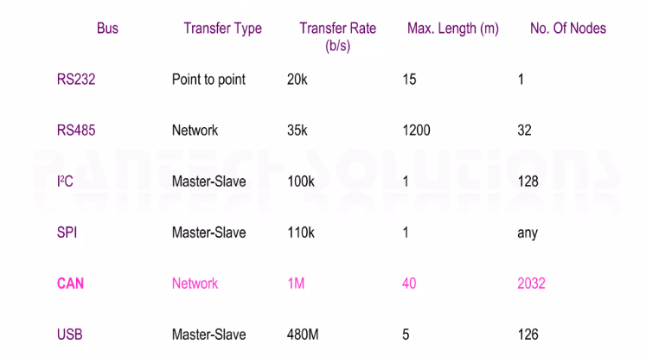
Comparing with Other Buses:

Slide 12
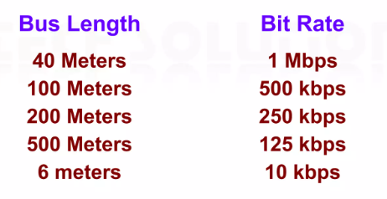
Cables:
Twisted pair cables are used to get higher speeds. The bit rate of the data transmission is high for short distance and low for long distance.

Slide 13
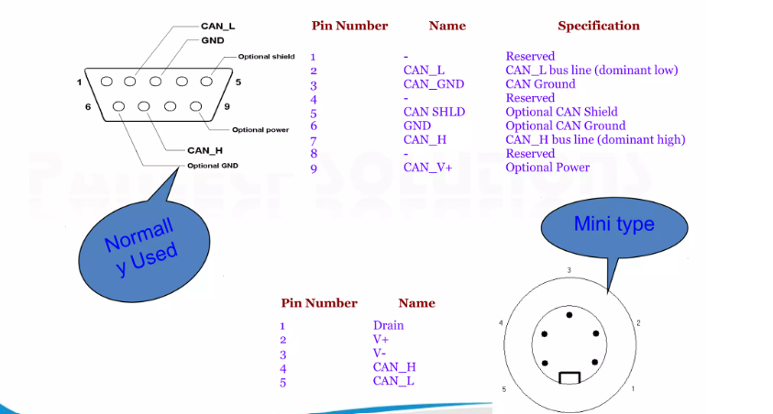
Connectors:

Slide 14
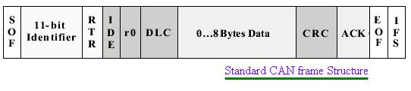
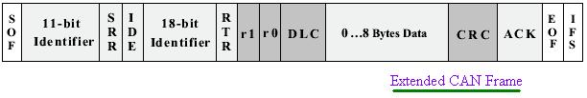
CAN Types:
CAN-A: Standard CAN
11-bit identifier.
It is mostly used in Passenger Vehicles.
CAN-B: Extended CAN
29-bit identifier
It is mostly used in Heavy load Vehicles (ex: Trucks, Buses).

Slide 15
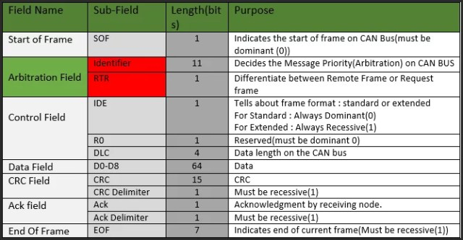
Standard CAN:
Note : Identifier available in standard CAN is 2048(2^11) but 2032 is available due to some implementation reason.

Slide 16
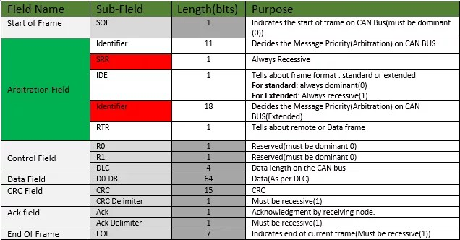
Extended CAN:
Note : Available Identifier in Extended CAN is about 500 million (2^29).

Slide 17
Frame Formats:
Data Frame
Remote Frame
Error Frame
Overload Frame

Slide 18
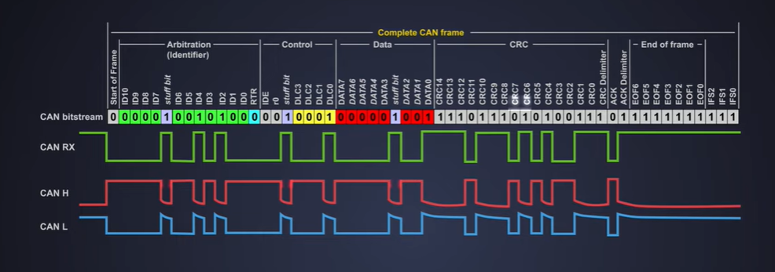
Data and Remote Frame:

Slide 19
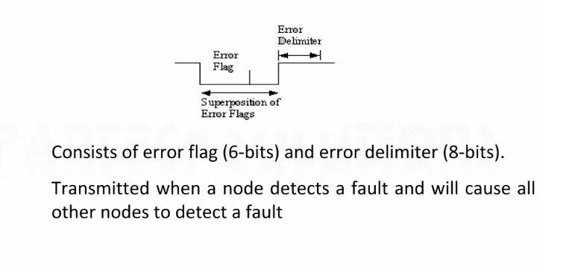
Error Frame:

Slide 20
Error Frame
The error frame consists of two different fields:
The first field is given by the superposition of ERROR FLAGS (6–12 dominant/recessive bits) contributed from different stations.
The following second field is the ERROR DELIMITER (8 recessive bits).
There are two types of error flags:
Active Error Flag :
six dominant bits – Transmitted by a node detecting an error on the network that is in error state error active.
Passive Error Flag :
six recessive bits – Transmitted by a node detecting an active error frame on the network that is in error state error passive.

Slide 21
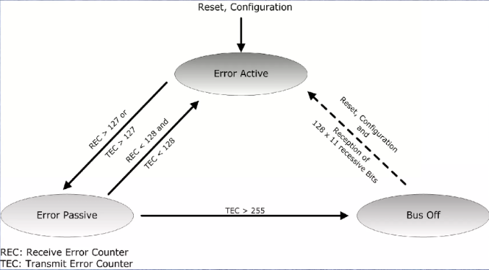
Fault Confinement

Slide 22
Overload Frame:
The overload frame contains the two-bit fields: Overload Flag and Overload Delimiter. There are two kinds of overload conditions that can lead to the transmission of an overload flag:
The internal conditions of a receiver, which requires a delay of the next data frame or remote frame.
Detection of a dominant bit during intermission.
The Overload Frame in the CAN protocol is a signaling mechanism to manage network congestion and prevent message collisions by indicating to other nodes that they should delay their transmissions.

Slide 23
Types of Errors:
Bit Error:
Bit Stuffing Error:
A CAN bit error occurs when the monitored value is different than the value being sent.
For instance, if a node is transmitting dominant (0) to the bus and recessive (1) is detected, this will cause a bit error.
To help ensure synchronization of the bus, bit stuffing is performed. Meaning, after 5 consecutive identical bits have been transmitted, a 6th opposite bit will be inserted by the transmitter into the bit stream.
If any node detects that the 6th consecutive bit remains of the same level, this will cause an error to be broadcasted on the bus.

Slide 24
ACK Error:
FORM Error:
During proper CAN transmission, a receiving node will write a dominant bit into the ACK slot and the transmitting node will acknowledge this message. However, if perhaps the receiver has failed, and the transmitting node doesn’t monitor a dominant bit and doesn’t acknowledge the message, an ACK error is flagged.
In CAN, the End of Frame, ACK Delimiter, and CRC Delimiter are all fixed format fields that are always recessive. If a node detects a dominant bit in any of these, a form error will be flagged.
CRC Error:
The transmitting node calculates a 15-bit CRC value and then transmits this value in the CRC field. All nodes will receive this message, calculate a CRC itself, and compare the values to determine if they are indeed the same. If not, this will produce a CRC error.

Slide 25
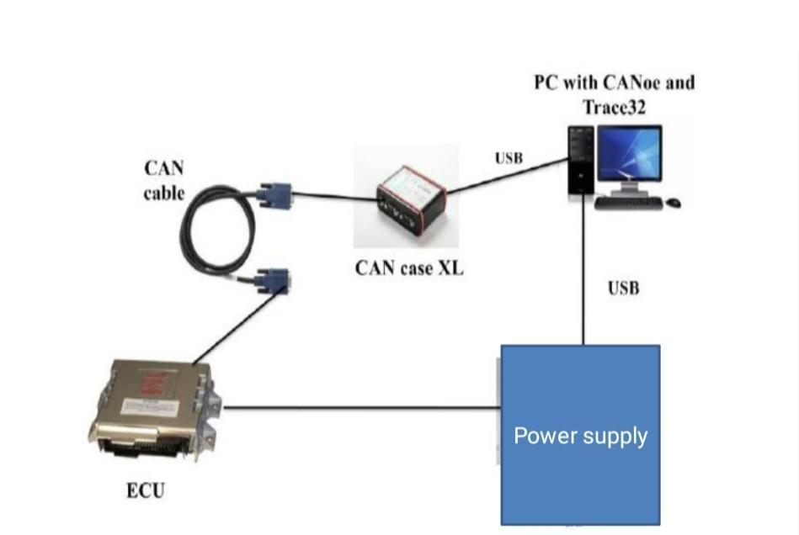

Slide 26
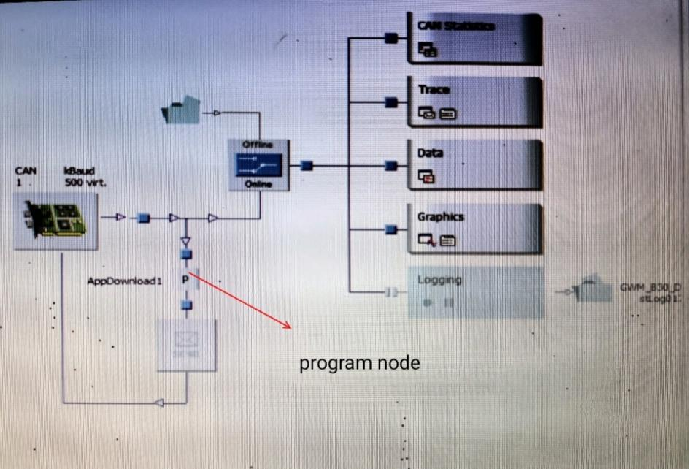

Slide 27
Thank you

